Slide 1

A minor project on Machine Learning-Based Car Model Prediction through Vehicle Pattern Recognition Under the guidance of Mrs. ANURADHA REDDY B.Tech M.Tech ,(Ph.D) Associate Professor of CSE
Presented by
SINGIREDDY MANOJ REDDY 21S11A05F5
RAPELLY SAHITH 21S11A05G9
MUTHAYALA SAI PRANAY 21S11A05H3
EERLA ADARSH 21S11A05D2

Slide 2
Contents
Abstract
Introduction
Existing System
Proposed system
System Requirements
System Architecture
Output Screens
Applications
Advantages
Conclusion

Slide 3
ABSTRACT:
In recent times, there has been a drastic change in people’s lifestyles and with an increase in incomes and lower cost of automobiles there is a huge increment in the number of cars on the roads which has led to traffic and commotion.
The manual efforts to keep people from breaking traffic rules such as the speed limit are not enough. There is not enough police and man force available to track the traffic and vehicles on roads and check them for speed control. Hence, we require technologically advanced speed calculators installed that effectively detect cars on the road and calculate their speeds.
To implement the above idea two basic requirements, need to be met which are the effective detection of the cars on roads and their velocity measurement. For this purpose, we can use OpenCV software which uses the Haar cascade to train our machine to detect the object, in this case the car.

Slide 4
INTRODUCTION:
In recent years, the automotive industry has witnessed significant advancements in technology, particularly in the realm of machine learning and computer vision. One of the fascinating applications of these technologies is the ability to accurately predict car models through vehicle pattern recognition.
Machine learning-based car model prediction leverages vast amounts of visual data to identify and classify vehicles based on their distinctive features.
Therefore, this project implements the deep CNN model for the prediction of a car model through the vehicle pattern recognition. It also provides the performance evaluation of existing machine learning models in terms of prediction accuracy.

Slide 5
EXISTING SYSTEM:
One of the technologies our law enforcement department uses to measure the speed of a moving vehicle is Doppler radar. It beams a radio wave at a vehicle, and then estimate the vehicles speed by measuring change in reflected wave frequency.
It is a fixed or hand-held device and is reliable when a moving object is in the field of view and no other moving objects are nearby. Cosine error has to be taken care if the gun is not in the line of sight. Also Radio interference which causes errors in speed detection has to be taken care. Over-speeding of two-wheelers and three wheelers is one of the major reasons of accidents.

Slide 6
DRAWBACKS OF EXISTING SYSTEM :
One major issue is the dependency on large, high-quality datasets for training the machine learning models. Inadequate or biased datasets can lead to poor generalization, resulting in inaccuracies when predicting car models for patterns not represented in the training data.
The computational complexity of some machine learning algorithms can also lead to slow processing times, making them less suitable for real-time applications. Moreover, the existing systems often lack robustness against adversarial attacks, where small perturbations in input data can cause significant misclassification.
Another drawback is the limited interpretability of some advanced machine learning models, such as deep neural networks, making it difficult to diagnose and correct prediction errors. These limitations underscore the need for more sophisticated approaches to improve reliability and scalability in diverse and dynamic environments.

Slide 7
PROPOSED SYSTEM:
The manual efforts to keep people from breaking traffic rules such as the speed limit are not enough. There is not enough police and man force available to track the traffic and vehicles on roads and check them for speed control.
To implement the above idea two basic requirements, need to be met which are the effective detection of the cars on roads and their velocity measurement.
In order to support traffic management system in our country we need to build economical traffic monitoring systems. In recent times image and video processing has been applied to the field of traffic management system

Slide 8
ADVANTAGES OF PROPOSED SYSTEM :
By integrating techniques such as deep learning and convolutional neural networks (CNNs), the system can effectively handle variations in lighting, angles, and occlusions, making it robust for real-world applications. The use of transfer learning further enhances its capability by utilizing pre-trained models, reducing the need for extensive datasets and minimizing training time.
Additionally, the proposed system can process data efficiently, making it suitable for real-time applications such as traffic monitoring, surveillance, and vehicle identification. Enhanced interpretability features may also be included,allowing stakeholders to understand the decision-making process of the model and improving trust in its predictions.
Furthermore, the system’s scalability ensures it can adapt to growing data and increasing diversity in car models, making it highly adaptable for various applications in automotive and security domains.

Slide 9
SYSTEM REQUIREMENTS:
HARDWARE REQUIREMENTS
System : Pentium IV 2.4 GHz.
Hard Disk : 40 GB.
Floppy Drive : 1.44 Mb.
Monitor : 15 VGA Colour.
Mouse : Logitech.
Ram : 512 Mb.
SOFTWARE REQUIREMENTS
Operating System: Windows
Coding Language: Python 3.7

Slide 10
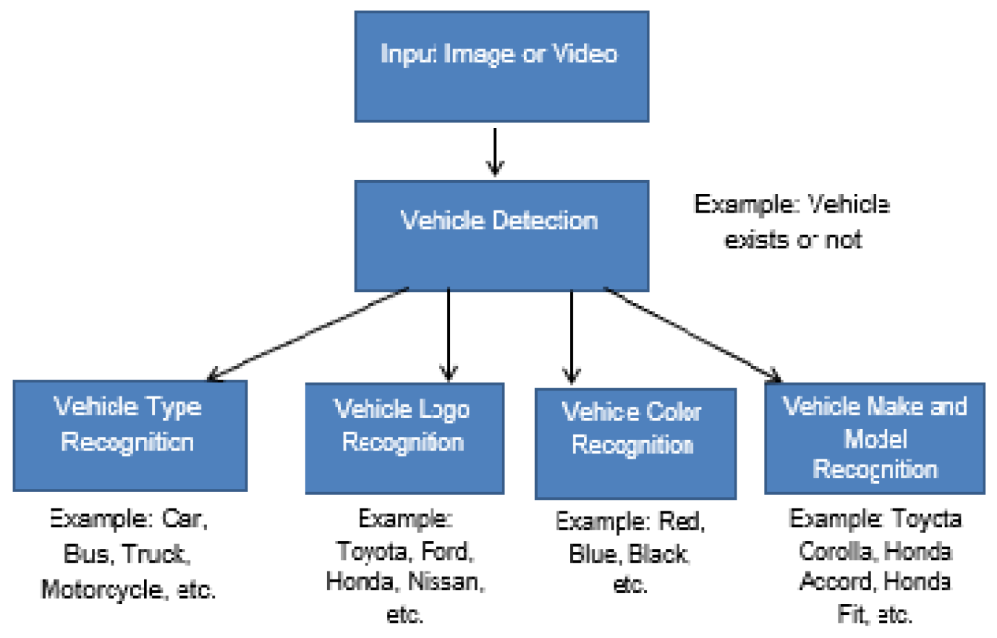
SYSTEM ARCHITECTURE :

Slide 11
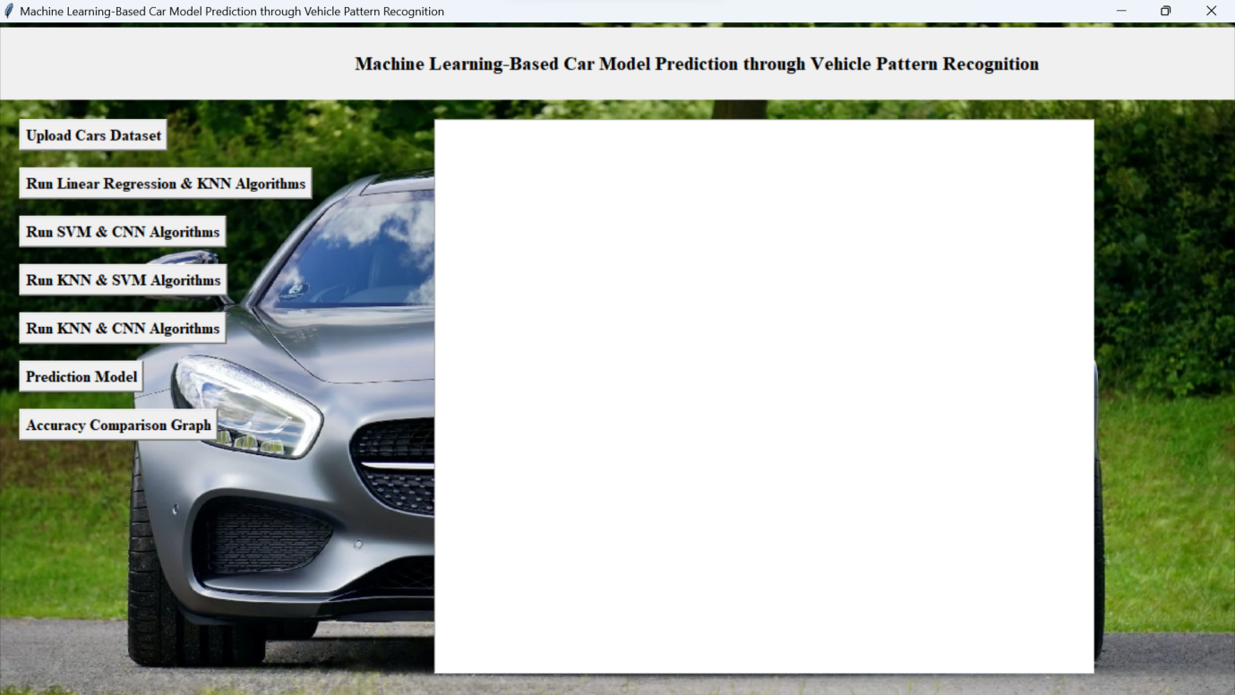
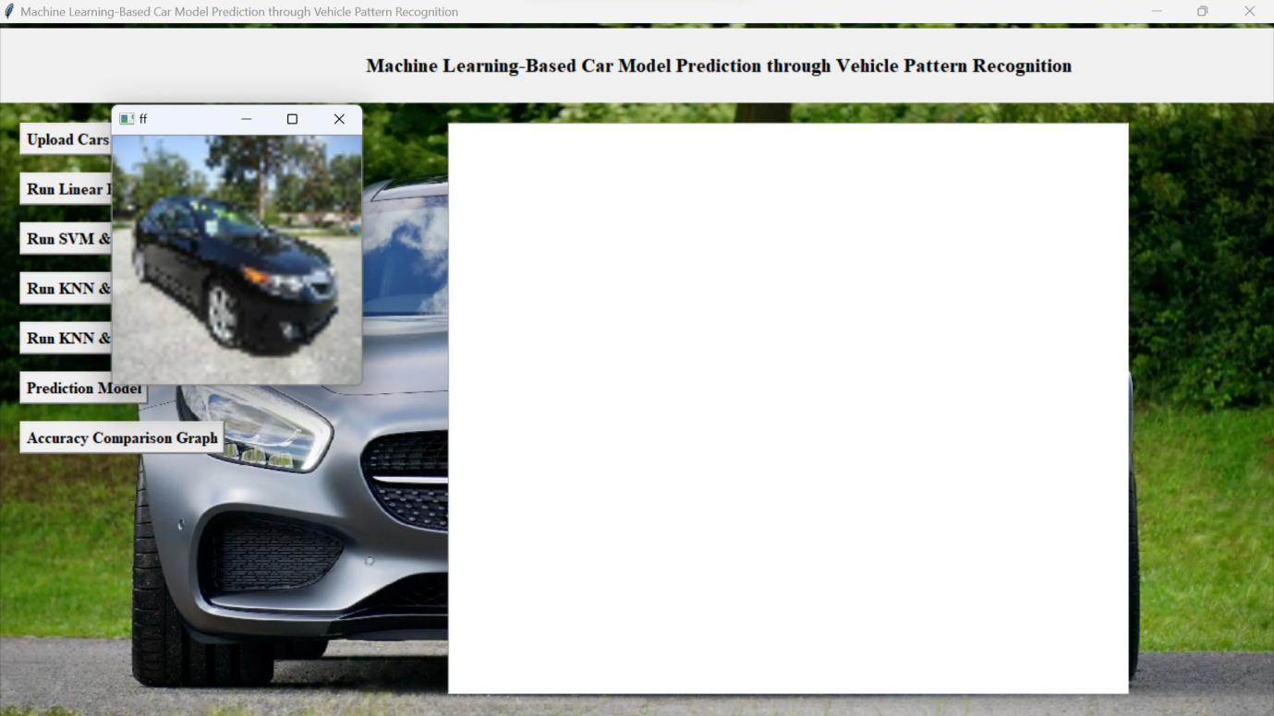
SCREENSHOTS :

Slide 12
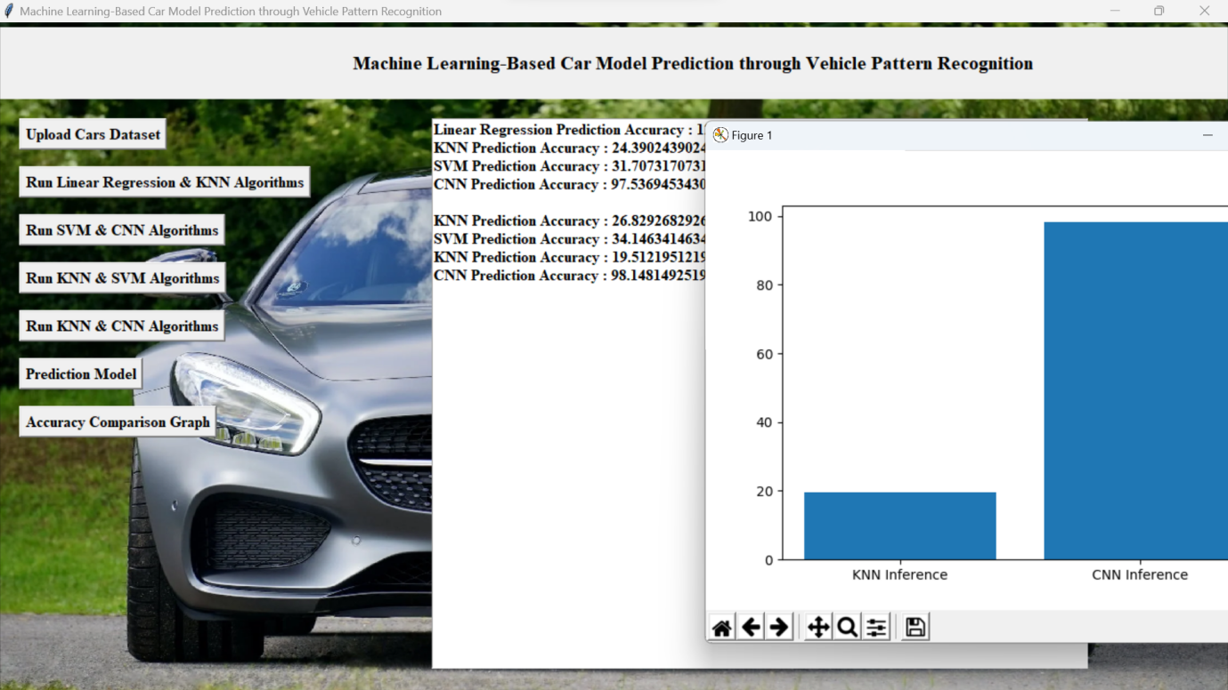
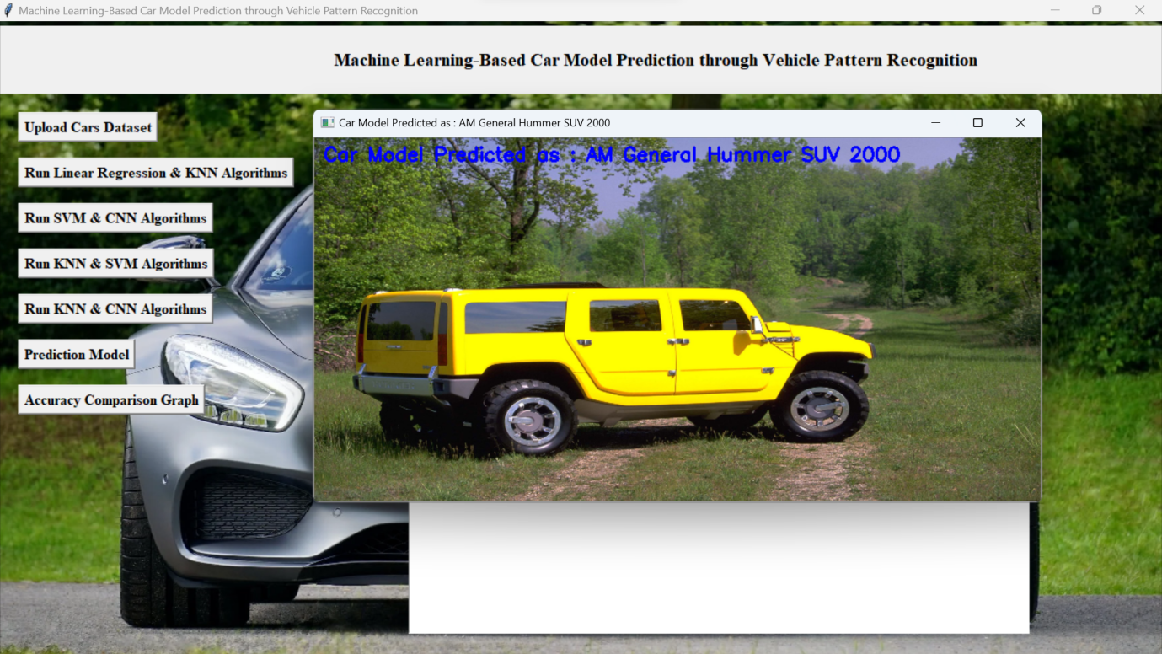

Slide 13
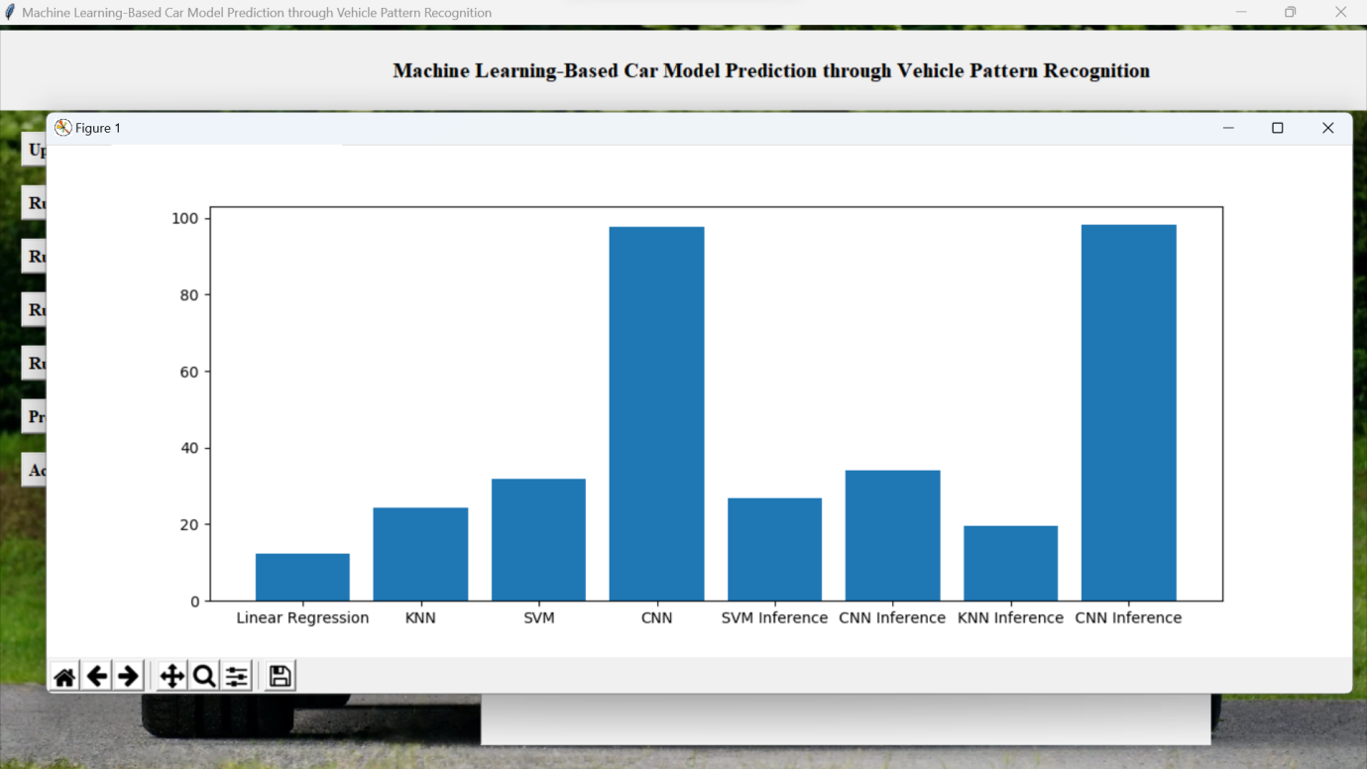

Slide 14
ADVANTAGES :
Easily identifies trends and patterns.
No human intervention needed (automation).
Continuous Improvement.
Wide Applications

Slide 15
CONCLUSION :
By employing frame subtraction and masking techniques, moving vehicles are segmented out. Speed is calculated using the time taken between frames and corner detected object traversed in that frames.
Finally frame masking is used to differentiate between one or more vehicles. With an average error of +/-2 km/h speed detection was achieved

Slide 16
THANK YOU

